Slide 1
Pattern Recognition
Chapter 4: Estimation and Learning _part I

Slide 2
Outline
Motivation
Parameter Learning
Maximum Likelihood Estimation
Estimation Bias
Bayesian Estimation

Slide 3
Motivation
From the previous chapter, we know that the Bayesian classifier achieves minimum probability of error.
Therefore, it performs better than MICD classifier for situations where the class conditional PDFs (p(x|c_{i})) are known.
Problem: In general, the PDFs are not known a priori, so how do we perform Bayesian classification?
Idea:
  What if we have samples with known class labels?
  With these samples, we can try to learn the PDFs of the individual classes.
  These empirical PDFs allow us to apply Bayesian classification!

Slide 4
Motivation
Bayesian classification is optimal in term of probability of error ONLY if the true class conditional PDFs (p(x|c_{i})) are known.
The use of empirical PDFs result in sub-optimal classifiers.
How close the performance is to the theoretical minimum P(ε) depends on the accuracy of the estimated PDF compared to the true PDF.

Slide 5
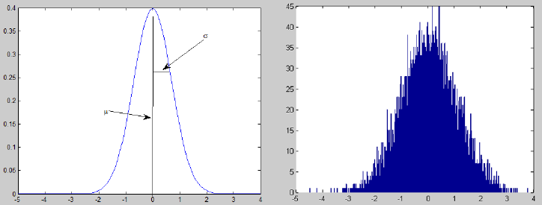
Categories of PDF learning
There are two main categories of PDF learning approaches:
  Parameteric Estimation: functional form of PDF is assumed to be known and the necessary parameters of the PDF are estimated.
  Non-parameteric Estimation: functional form of PDF is not assumed to be known and the PDF is estimated directly.

Slide 6
Parametric Estimation
Here, we assume that we know the class conditional probability function, but we don’t know the parameters that define this function.
For example,
  Suppose that p(x|A) is multivariate Normal, N(μ_{a},∑_{a})
  We may not know what the actual value of parameters μ_{a} and/or ∑_{a} are.
In this scenario, what we want to do is estimate what these parameters are based on a set of labeled samples for the class!

Slide 7
Types of Parameter Estimation
There are two main categories of parametric estimation approaches:
Maximum Likelihood Estimation: Treat parameters as being fixed but unknown quantities, with the goal of finding estimate values which maximize the probability that the given samples came from the resulting PDF p(x|θ).
Bayesian(Maximum a Posterior)Estimation: Treat parameters as random variables with an assumed a priori distribution, with the goal of obtaining an a posteriori distribution p(θ |x) which indicates the estimate value based on the given samples.

Slide 8
Maximum Likelihood Estimation
Supposed that we are given a set of samples {x_{i}},independently drawn from a distribution p(x) where the form of the PDF is known (e.g., Gaussian)
The goal is to obtain estimates for the parameters θ that defines this PDF.
For example, if the distribution is of the Gaussian form: p(x|A) =N(μ_{a},∑_{a})
then the set of parameters defining this distribution is θ=(μ_{a},∑_{a})

Slide 9

Maximum Likelihood Estimation
Writing the PDF as p(x|θ) to emphasize the dependence on parameters, the Maximum Likelihood estimate of the parameters θ is the set of parameters that maximizes the probability that the given samples {x₁,x₂ ,…,x_{N} } are obtained given θ:

Slide 10
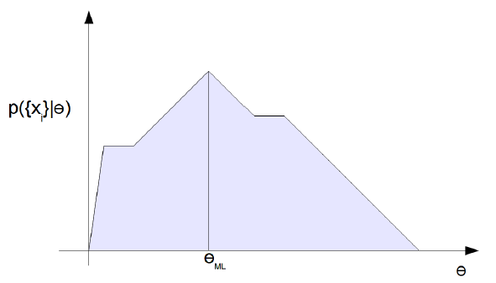
Maximum Likelihood Estimation
Given the observation {x_{i}}, the maximum likelihood estimate of parameter θ is chosen to be the value which maximizes the p({x_{i}}|θ)

Slide 11

Maximum Likelihood Estimation
Assuming that the sample are independent of each other, then
Therefore, the sample set probability is just the product of the individual sample probability.

Slide 12



Maximum Likelihood Estimation
To maximize p({x_{i}}|θ), we take the derivative and set it to zero:
It is often more convenient to deal with it in log form
This gives us the final maximum likelihood condition:

Slide 13
MLE example-1
Suppose we know the PDF is a Normal distribution N(μ,σ²), and we know the variance but do not know the mean.
What is the Maximum Likelihood estimate of the mean μ?

Slide 14
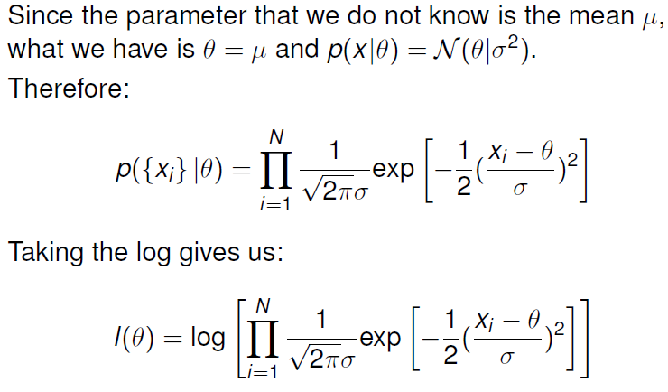
MLE example-1

Slide 15
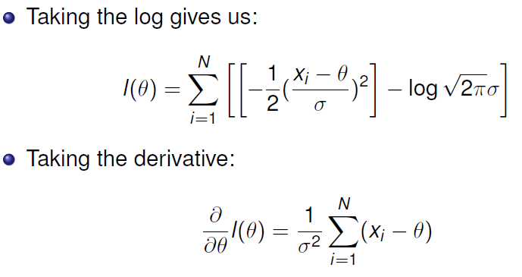
MLE example-1

Slide 16
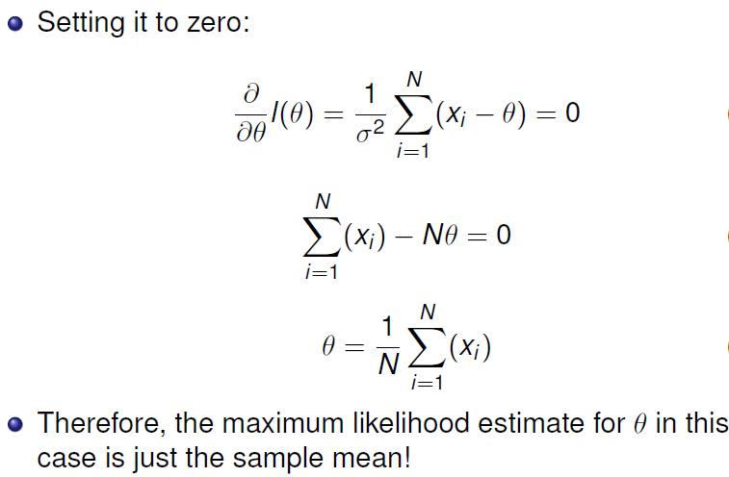
MLE example-1

Slide 17
MLE example-2
Suppose we know the PDF is a Normal distribution N(μ,σ²), and we do not know the variance and the mean.
What is the Maximum Likelihood estimate of the mean μ and variance σ²?

Slide 18
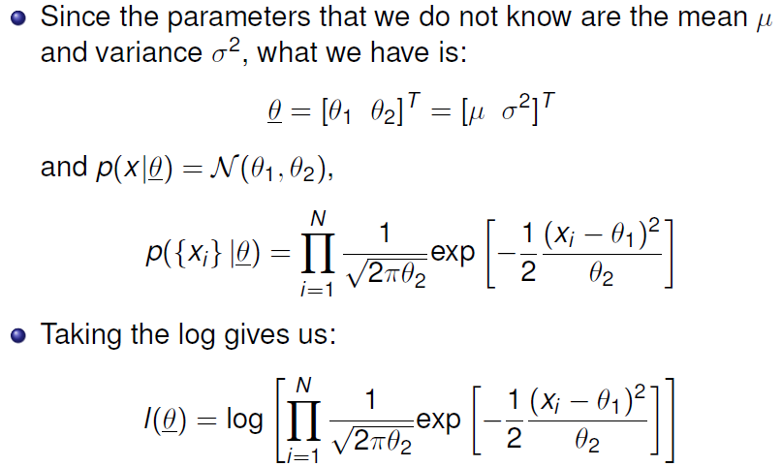
MLE example-2

Slide 19
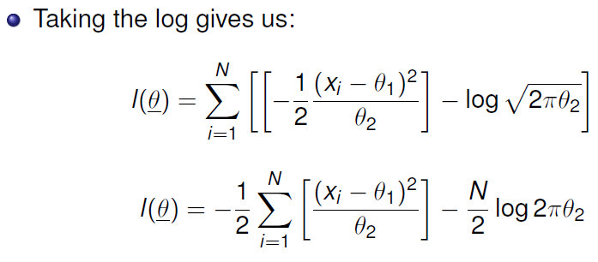
MLE example-2

Slide 20
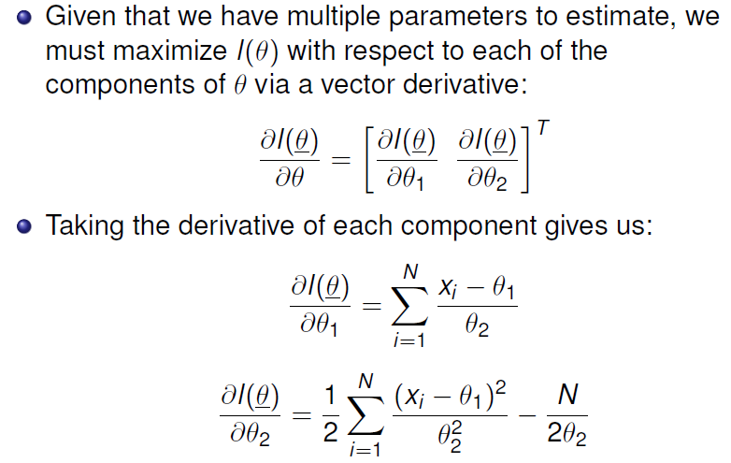
MLE example-2

Slide 21
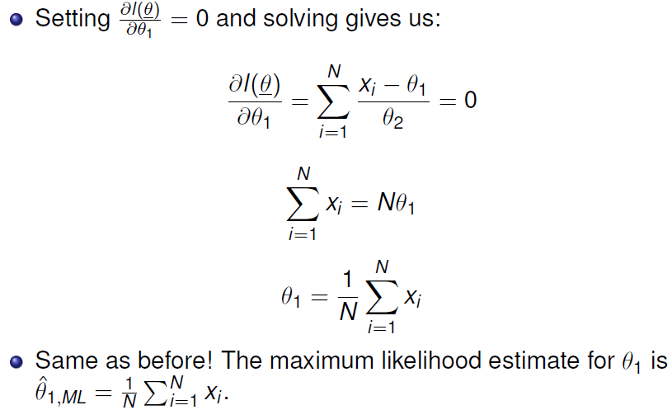
MLE example-2

Slide 22
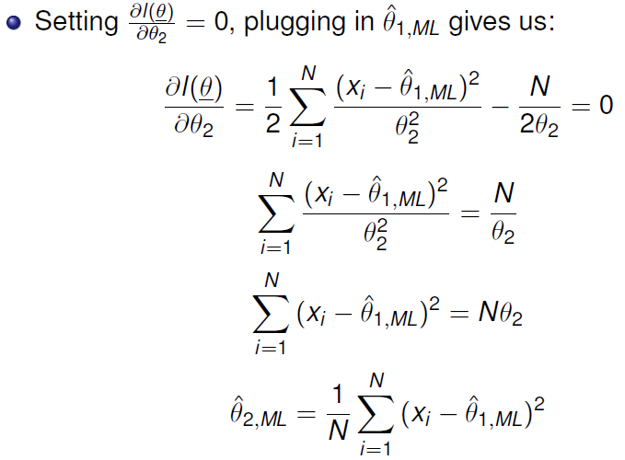
MLE example-2

Slide 23
MLE example-3
Suppose we know the PDF is a multivariate Normal distribution N(μ,∑), and we do not know the covariance matrix and the mean vector.
What is the Maximum Likelihood estimate of the mean vector μ and covariance matrix ∑?

Slide 24
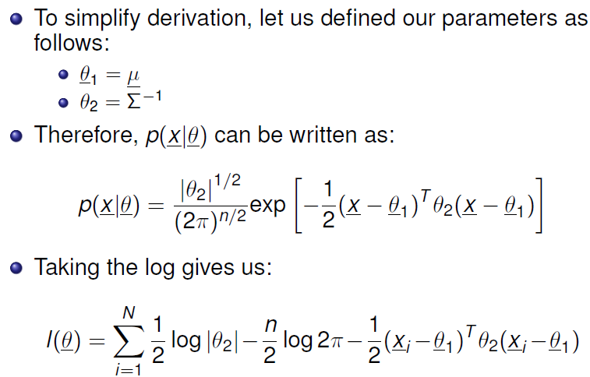
MLE example-3

Slide 25
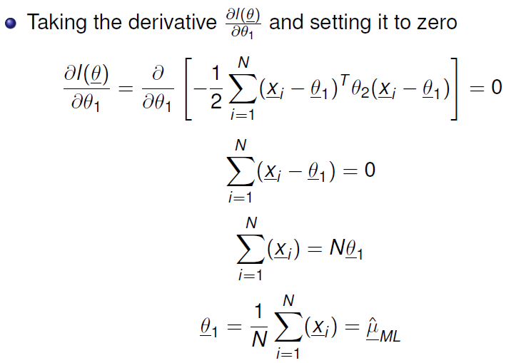
MLE example-3

Slide 26
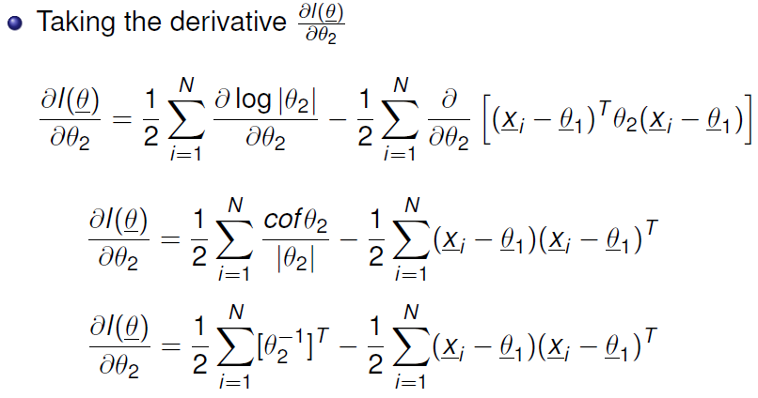
MLE example-3

Slide 27
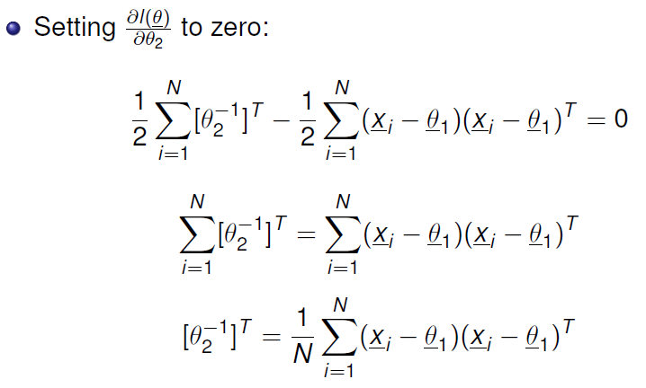
MLE example-3

Slide 28
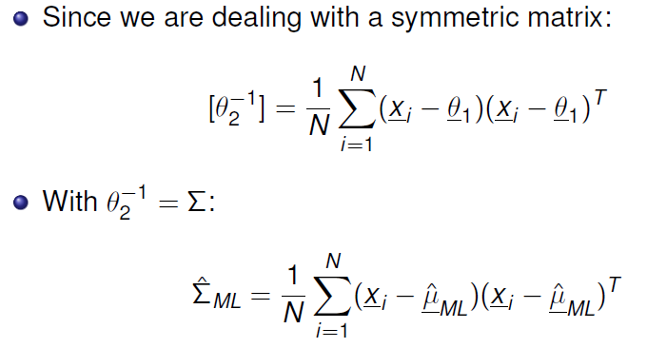
MLE example-3

Slide 29
Bayesian Estimation
Idea: instead of treating the parameters as fixed and finding the parameters that maximize the probability that the given samples come from the resulting PDF, we do the following:
  Treat the parameters as random variables with an assumed a priori distribution.
  Use the observed samples to obtain a posterior distribution which indicates the parameters!

Slide 30
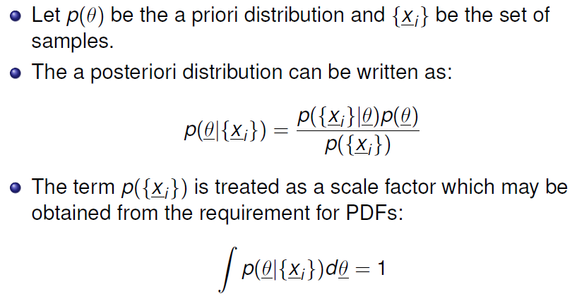
Bayesian Estimation

Slide 31
Example
Suppose that we would like to learn the underlying PDF and we are given the following information:
we know the PDF is a univariate Normal distribution N(μ,σ²), and we know the variance but do not know the mean.
What is the Bayesian estimate of the mean μ?

Slide 32
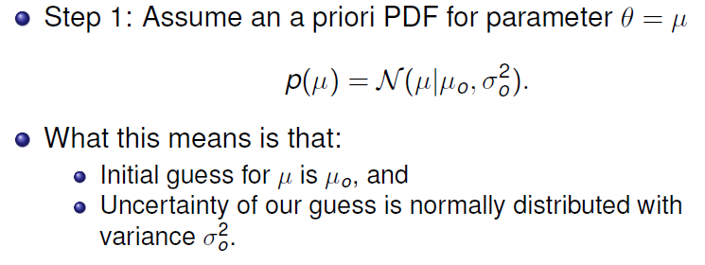
Example
Notes:
Miu0 和sigma0是已知的。例如，过去的经验证明参数miu的估计值应是miu0,这个估计值是有一定准确性的（由sigma0表现）

Slide 33
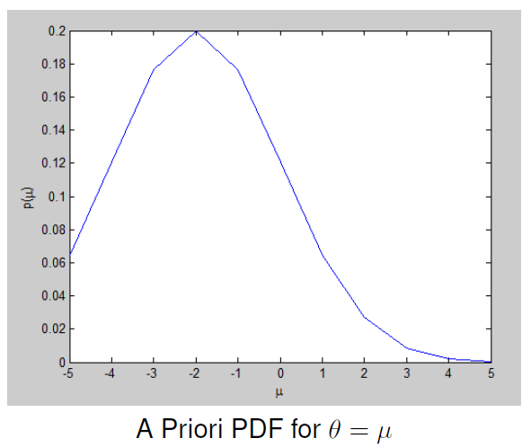
Example

Slide 34
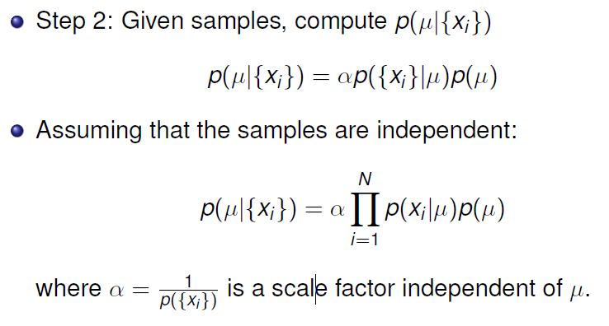
Example

Slide 35
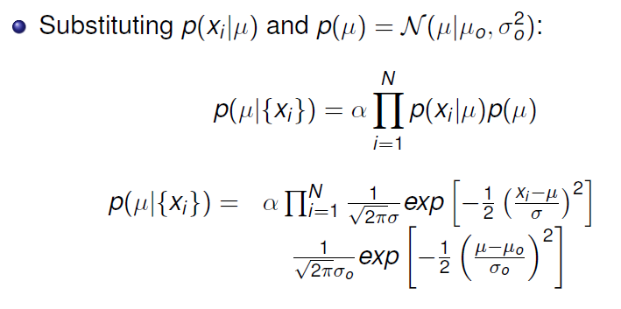
Example

Slide 36
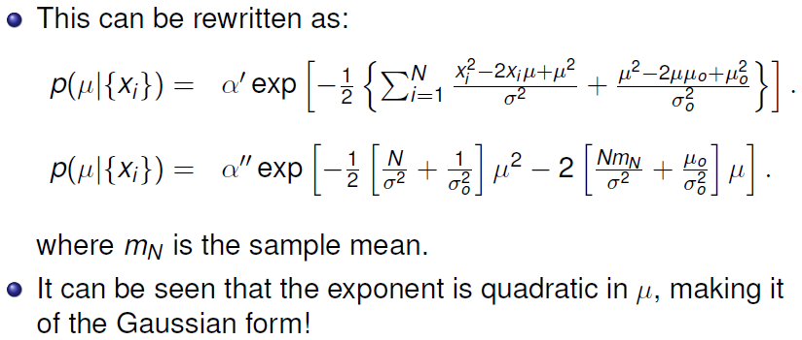
Example

Slide 37
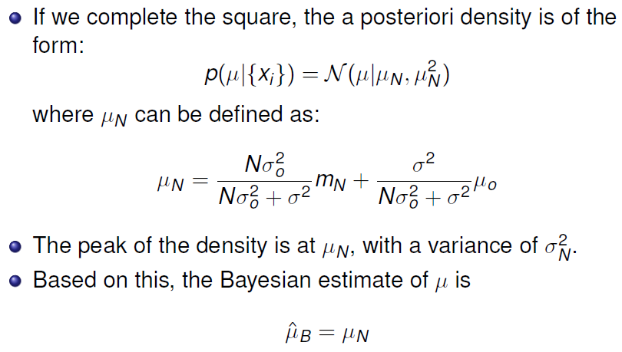
Example

Slide 38
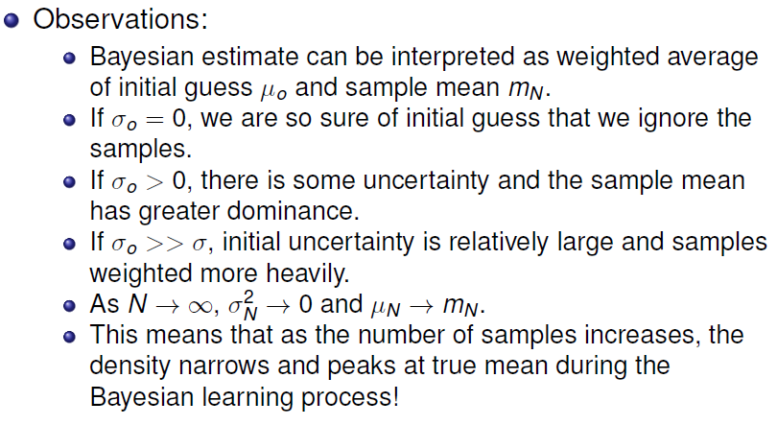
Example

Slide 39
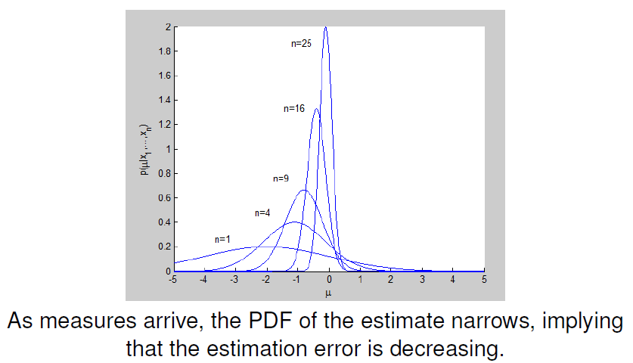
Example

